Slide 1
ADVANCED DATA STRUCTURES
By
Sr. Asst.Prof. S Neelima
Dept of Information Technology
Aditya Engineering College(A)
Surampalem.

Slide 2
UNIT-III

Slide 3
Efficient Binary Search Trees
Binary Search Trees
We consider a particular kind of a binary tree called a Binary Search Tree (BST).
The basic idea behind this data structure is to have such a storing repository that provides the efficient way of data sorting, searching and retriving.

Slide 4
A BST is a binary tree where nodes are ordered in the following way:each node contains one key (also known as data)
the keys in the left subtree are less then the key in its parent node, in short L < P;
the keys in the right subtree are greater the key in its parent node, in short P < R;
duplicate keys are not allowed.

Slide 5
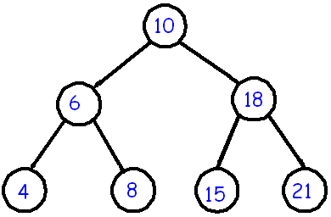
In the above tree all nodes in the left subtree of 10 have keys < 10 while all nodes in the right subtree > 10. Because both the left and right subtrees of a BST are again search trees; the above definition is recursively applied to all internal nodes:

Slide 6
Basic operations on a BST
Create: creates an empty tree.
Insert: insert a node in the tree.
Search: Searches for a node in the tree.
Delete: deletes a node from the tree.
Inorder: in-order traversal of the tree.
Preorder: pre-order traversal of the tree.
Postorder: post-order traversal of the tree.

Slide 7
Self-Balancing Binary Search Trees
Self-Balancing Binary Search Trees are height-balanced binary search trees that automatically keeps height as small as possible when insertion and deletion operations are performed on tree.

Slide 8
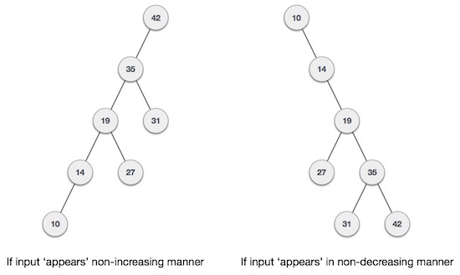

Slide 9
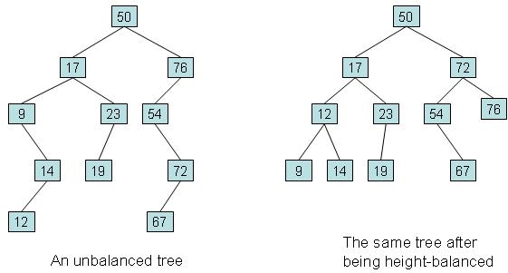

Slide 10
So, a binary tree is said to be balanced if the height of left and right children of every node differ by either -1, 0 or +1. This value is known as the balance factor.
Balance factor = Height of the left subtree - Height of the right subtree
(or)
Balance factor:
The balance factor of a binary tree is the difference in height between its left and right sub trees.
i.e. Balance factor = H_{L} - H_{R}

Slide 11
AVL TREES
In 1962, two Russian mathematicians, G.M Adelson – velskii and E.M Landis, aerated the balanced binary tree structure that is named after them – the AVL tree.
An AVL tree is a search tree in which the heights of the sub trees differ by no more than 1. It is thus a balanced binary tree.
An AVL tree is a binary tree that either is empty or consists of two AVL sub tree, T_{L} and T_{R}, whose heights differ by no more than 1.
| H_{L} - H_{R} | < = 1
Where H_{L} is the height of the left sub tree, H_{R} is the height of the right sub tree
The bar symbols indicate absolute value.

Slide 12
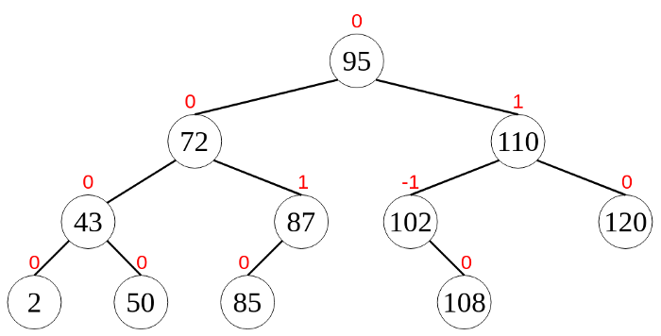
Consider an example: AVL tree

Slide 13
AVL Tree Balance factor:
The Balance factor for any node in an AVL tree must be +1, 0, -1.
We use the descriptive identifiers
LH for left high (+1) to indicate that the length sub tree is higher than the right sub tree
EH for even high (0) to indicate that the sub tree are the same height
RH for right high (-1) to indicate that the left sub tree is shortest than the right sub tree

Slide 14
Rotations in AVL Trees
After performing insertions or deletions in an AVL tree, we have to check whether the balance factor condition is satisfied by all the nodes. If the tree is not balanced, then we have to do rotations to make it balanced.
Rotations performed on AVL trees can be of four main types that are grouped under two categories. They are,
1.Single rotations — Left (LL) Rotation and Right (RR) Rotation
2.Double rotations — Left Right (LR) Rotation and Right Left (RL) Rotation

Slide 15
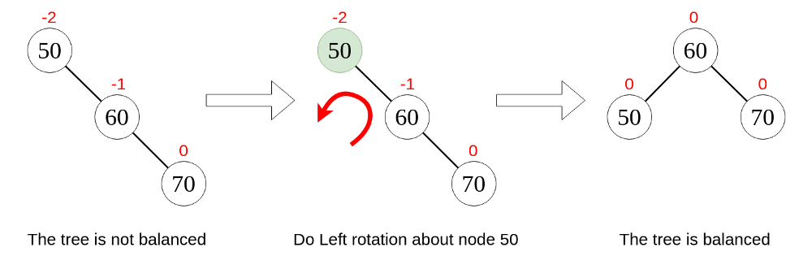
Single Left Rotation (LL Rotation)

Slide 16
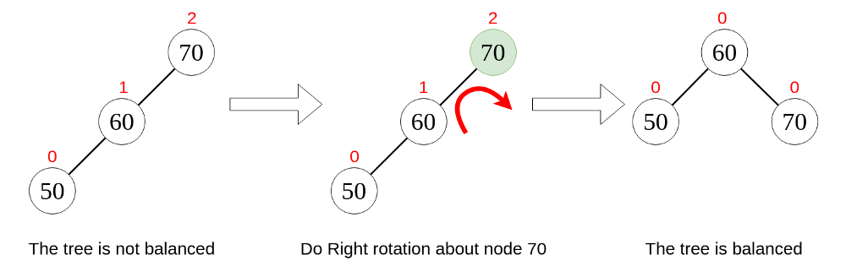
2. Single Right Rotation (RR Rotation)
In this type of rotation, we move all the nodes to the right by one position.

Slide 17
3. Left Right Rotation (LR Rotation)
As the name implies, this type of rotation consists of a left rotation and a right rotation.

Slide 18
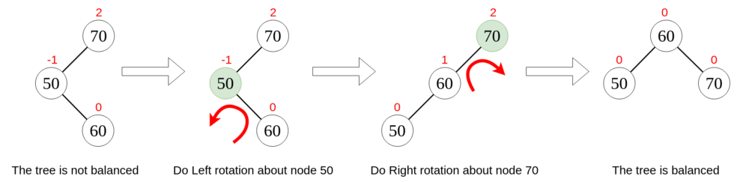

Slide 19
4. Right Left Rotation (RL Rotation)
This type of rotation consists of a right rotation followed by a left rotation.

Slide 20
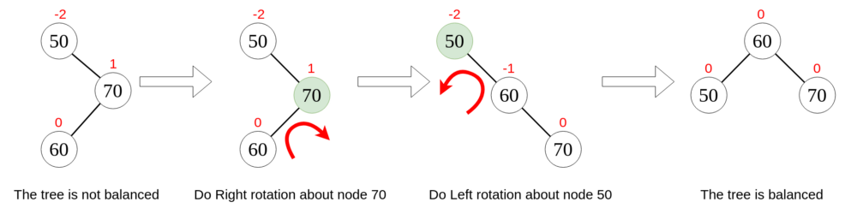

Slide 21
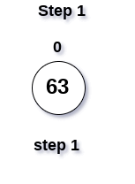
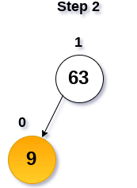
Construct an AVL tree by inserting the following elements in the given order.
63, 9, 19, 27, 18, 108, 99, 81

Slide 22
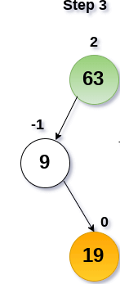

Slide 23
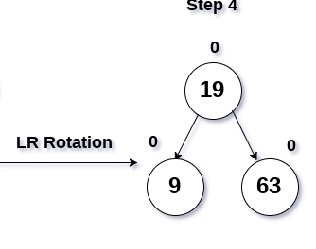

Slide 24
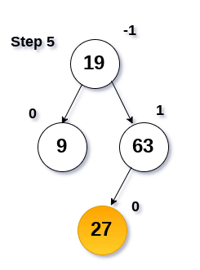
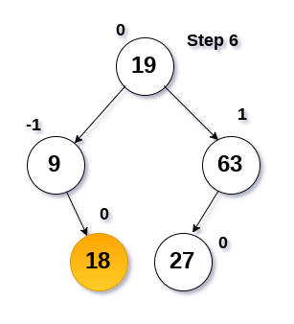

Slide 25
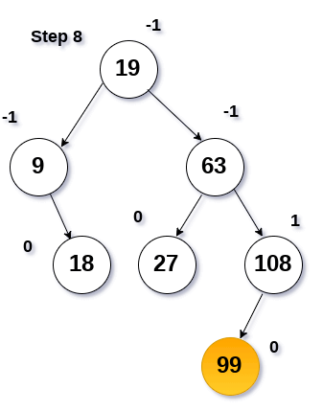
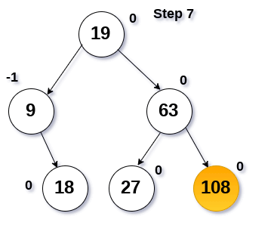

Slide 26
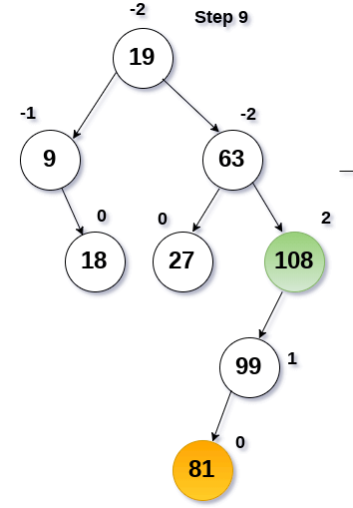

Slide 27
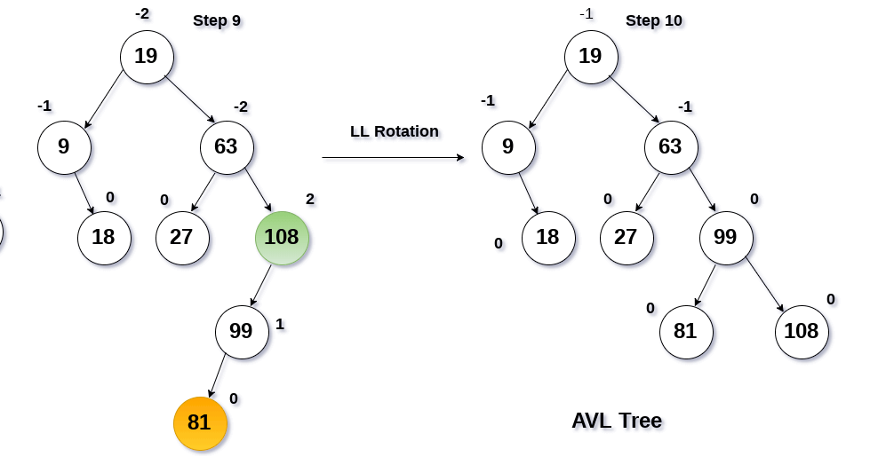

Slide 28

Construct AVL Tree for the following sequence of numbers-
50 , 20 , 60 , 10 , 8 , 15 , 32 , 46 , 11 , 48
Step-01: Insert 50

Slide 29
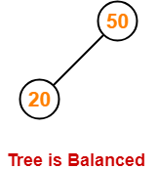
Step-02: Insert 20
As 20 < 50, so insert 20 in 50’s left sub tree.

Slide 30
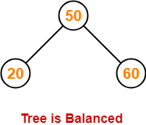
Step-03: Insert 60
As 60 > 50, so insert 60 in 50’s right sub tree.

Slide 31
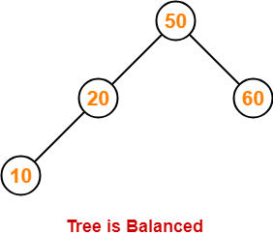
Step-04: Insert 10
As 10 < 50, so insert 10 in 50’s left sub tree.
As 10 < 20, so insert 10 in 20’s left sub tree.

Slide 32
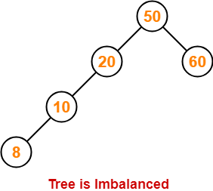
Step-05: Insert 8
As 8 < 50, so insert 8 in 50’s left sub tree.
As 8 < 20, so insert 8 in 20’s left sub tree.
As 8 < 10, so insert 8 in 10’s left sub tree.

Slide 33
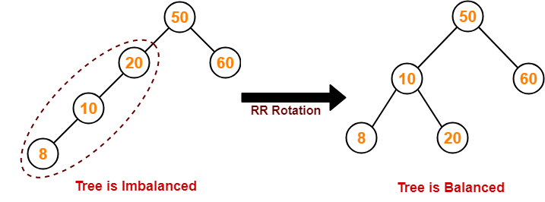

Slide 34
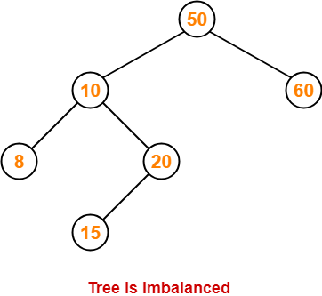
Step-06: Insert 15
As 15 < 50, so insert 15 in 50’s left sub tree.
As 15 > 10, so insert 15 in 10’s right sub tree.
As 15 < 20, so insert 15 in 20’s left sub tree.

Slide 35
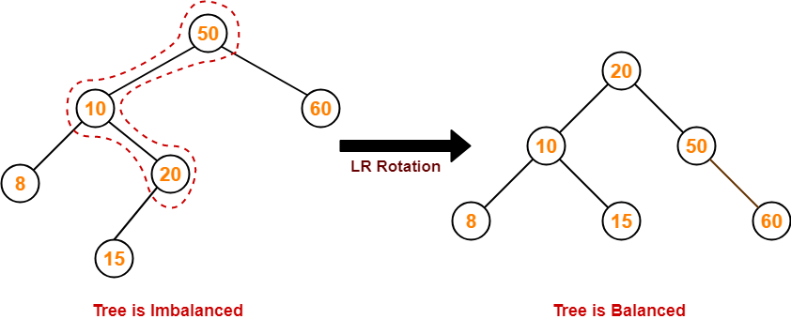

Slide 36
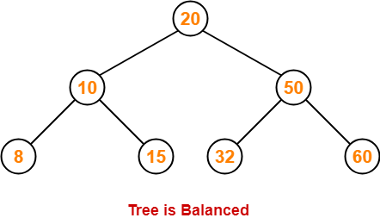
Step-07: Insert 32
As 32 > 20, so insert 32 in 20’s right sub tree.
As 32 < 50, so insert 32 in 50’s left sub tree.

Slide 37
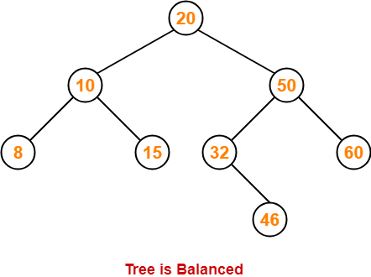
Step-08: Insert 46
As 46 > 20, so insert 46 in 20’s right sub tree.
As 46 < 50, so insert 46 in 50’s left sub tree.
As 46 > 32, so insert 46 in 32’s right sub tree.

Slide 38
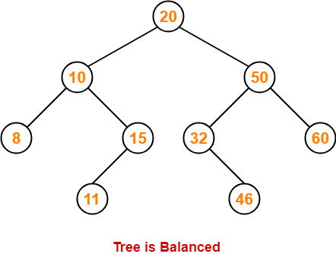
Step-09: Insert 11
As 11 < 20, so insert 11 in 20’s left sub tree.
As 11 > 10, so insert 11 in 10’s right sub tree.
As 11 < 15, so insert 11 in 15’s left sub tree.

Slide 39
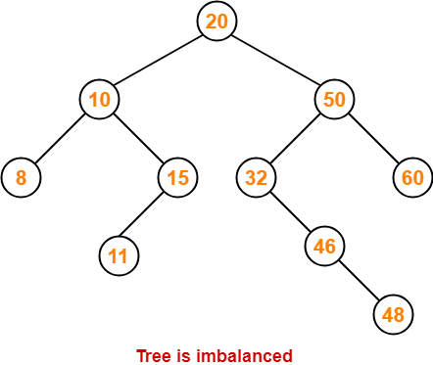
Step-10: Insert 48
As 48 > 20, so insert 48 in 20’s right sub tree.
As 48 < 50, so insert 48 in 50’s left sub tree.
As 48 > 32, so insert 48 in 32’s right sub tree.
As 48 > 46, so insert 48 in 46’s right sub tree.

Slide 40
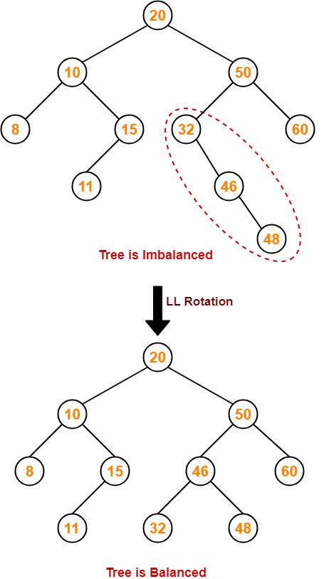

Slide 41
Deletion from an AVL Search Tree
As with insertions, a node is deleted using the standard inorder successor (predecessor) logic for binary search trees. But, just like insertion, deletion can cause an imbalance, which will need to be fixed by applying one of the four rotations.

Slide 42
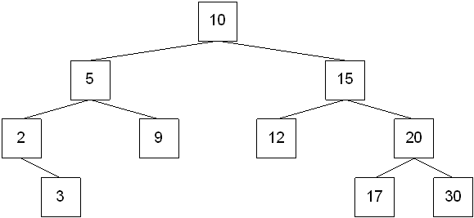

Slide 43
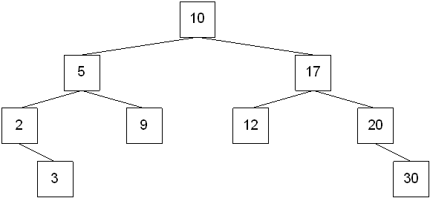
Now suppose that the nodes 15 and 12 are deleted. The resulting tree is:
Delete 15 using INORDER SUCCESSOR logic:

Slide 44
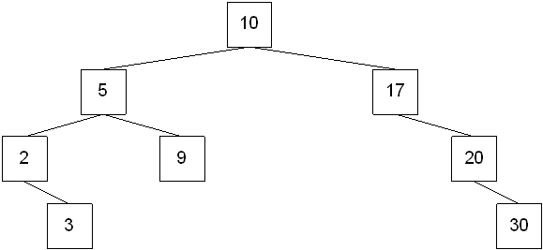
Delete 12 using INORDER SUCCESSOR logic:

Slide 45
If we identify the parent of the actual node that was deleted, then:
If the left child was deleted, the balance factor at the parent decreased by 1.
If the right child was deleted, the balance factor at the parent increased by 1.
The change in balance factor can move up the tree from the deleted node's parent all the way to the root. Therefore, it's possible that a node's balance factor could become +2 or -2. If this happens, then balance needs to be restored.

Slide 46
Let A be the node where balance must be restored. If the deleted node was in A's right subtree, then let B be the root of A's left subtree. Then:
B has balance factor 0 or +1 after deletion -- then perform a single right rotation
B has balance factor -1 after deletion -- then perform a left-right rotation
If the deleted node was in A's left subtree, then let B be the root of A's right subtree. Then:
B has balance factor 0 or -1 after deletion -- then perform a single left rotation
B has balance factor +1 after deletion -- then perform a right-left rotation

Slide 47
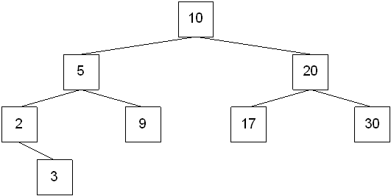

Slide 48
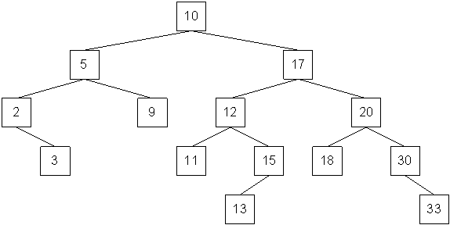
Delete 9 from the tree.

Slide 49
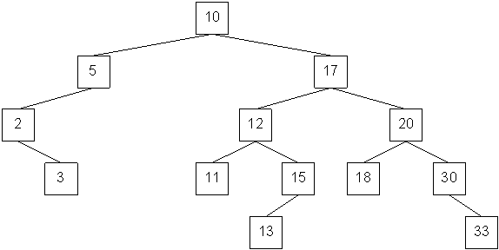

Slide 51
Unlike insertions, one rotation may not be enough to restore balance to the tree. If this is the case, then locate the next node where the balance factor is "bad" (call this A):
If A's balance factor is positive, then let B be A's left child
  If B's left subtree height is larger than B's right subtree height, then perform a single right rotation.
  If B's left subtree height is smaller than B's right subtree height, then perform a left-right rotation.
  If B's left subtree height is equal to B's right subtree height, then perform either rotation.

Slide 52
If A's balance factor is negative, then let B be A's right child
  If B's right subtree height is larger than B's left subtree height, then perform a single left rotation.
  If B's right subtree height is smaller than B's left subtree height, then perform a right-left rotation.
  If B's right subtree height is equal to B's left subtree height, then perform either rotation.

Slide 53
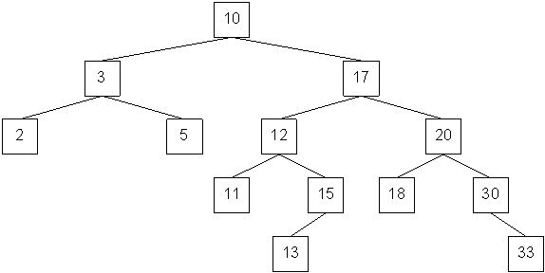

Slide 54
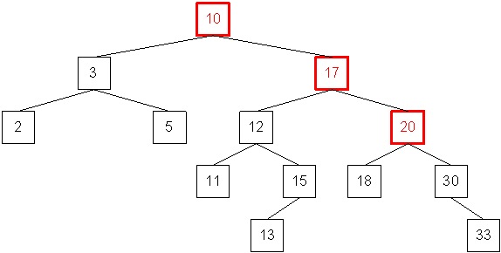
A single left rotation with the highlighted nodes

Slide 55
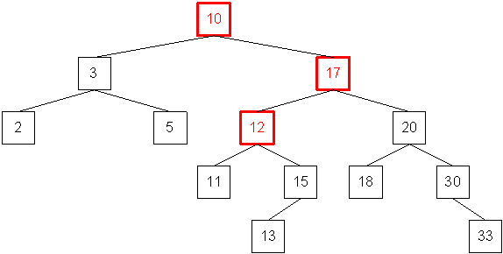
OR a right-left rotation with the highlighted nodes

Slide 56
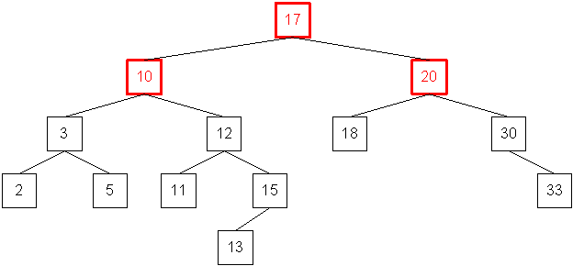
Result after the single left rotation:

Slide 57
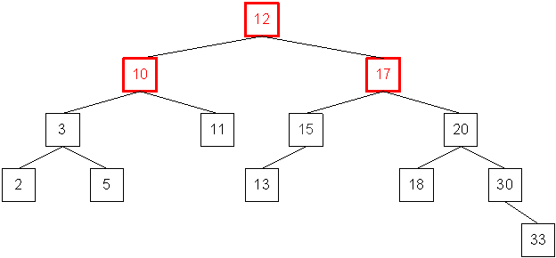
Result after the right-left rotation:

Slide 58
Insertion Algorithm
Step 1 − Create a node
Step 2 − Check if the tree is empty
Step 3 − If the tree is empty, the new node created will become the root node of the AVL Tree.
Step 4 − If the tree is not empty, we perform the Binary Search Tree insertion operation and check the balancing factor of the node in the tree.
Step 5 − Suppose the balancing factor exceeds ±1, we apply suitable rotations on the said node and resume the insertion from Step 4.

Slide 59
Deletion Algorithm
Step 1: START
Step 2: Find the node in the tree. If the element is not found, go to step 7.
Step 3: Delete the node using BST deletion logic.
Step 4: Calculate and check the balance factor of each node.
Step 5: If the balance factor follows the AVL criterion, go to step 7.
Step 6: Else, perform tree rotations to balance the unbalanced nodes. Once the tree is balanced go to step 7.
Step 7: END

Slide 60
B Tree
B Tree is a specialized m-way tree that can be widely used for disk access. A B-Tree of order m can have at most m-1 keys and m children. One of the main reason of using B tree is its capability to store large number of keys in a single node and large key values by keeping the height of the tree relatively small.
A B tree of order m contains all the properties of an M way tree. In addition, it contains the following properties.
Every node in a B-Tree contains at most m children.
Every node in a B-Tree except the root node and the leaf node contain at least m/2 children.
The root nodes must have at least 2 nodes.
All leaf nodes must be at the same level.
It is not necessary that, all the nodes contain the same number of children but, each node must have m/2 number of nodes.

Slide 61
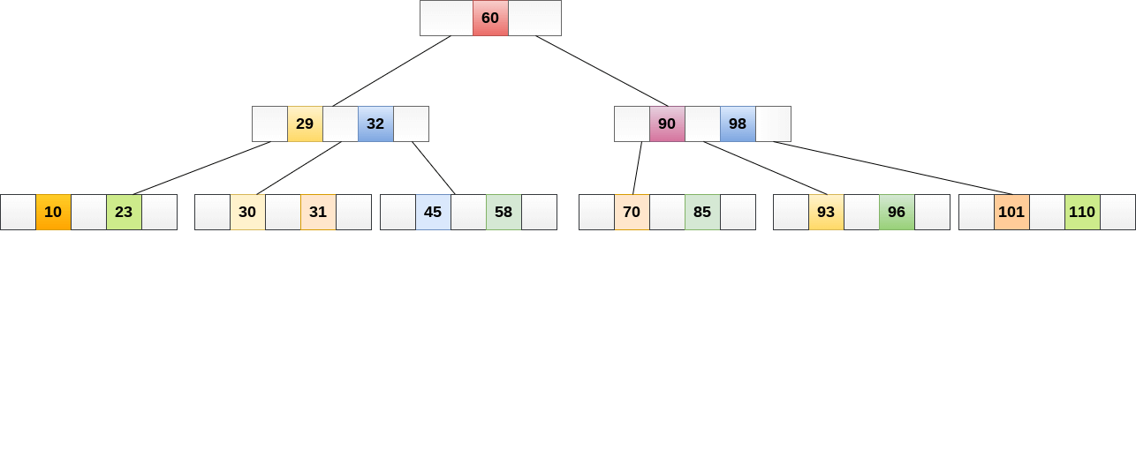
A B tree of order 4 is shown in the following image.

Slide 62
While performing some operations on B Tree, any property of B Tree may violate such as number of minimum children a node can have. To maintain the properties of B Tree, the tree may split or join.
Operations
1.Searching :
Searching in B Trees is similar to that in Binary search tree. For example, if we search for an item 49 in the following B Tree. The process will something like following :
Compare item 49 with root node 78. since 49 < 78 hence, move to its left sub-tree.
Since, 40<49<56, traverse right sub-tree of 40.
49>45, move to right. Compare 49.
match found, return.
Searching in a B tree depends upon the height of the tree. The search algorithm takes O(log n) time to search any element in a B tree.

Slide 63
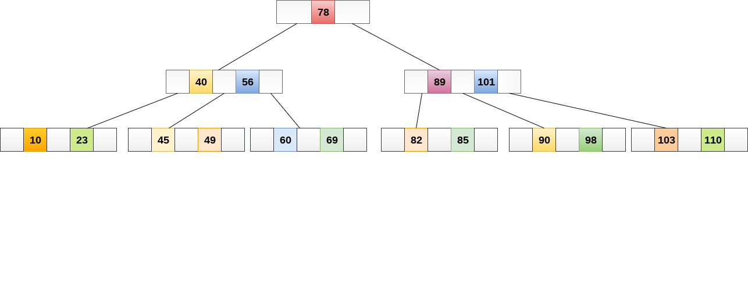

Slide 64
2.Insertion
Insertions are done at the leaf node level. The following algorithm needs to be followed in order to insert an item into B Tree.
Traverse the B Tree in order to find the appropriate leaf node at which the node can be inserted.
If the leaf node contain less than m-1 keys then insert the element in the increasing order.
Else, if the leaf node contains m-1 keys, then follow the following steps.
  Insert the new element in the increasing order of elements.
  Split the node into the two nodes at the median.
  Push the median element upto its parent node.
  If the parent node also contain m-1 number of keys, then split it too by following the same steps.

Slide 65
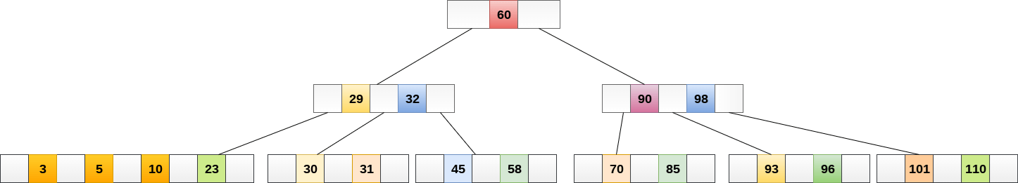
Example:
Insert the node 8 into the B Tree of order 5 shown in the following image.

Slide 66
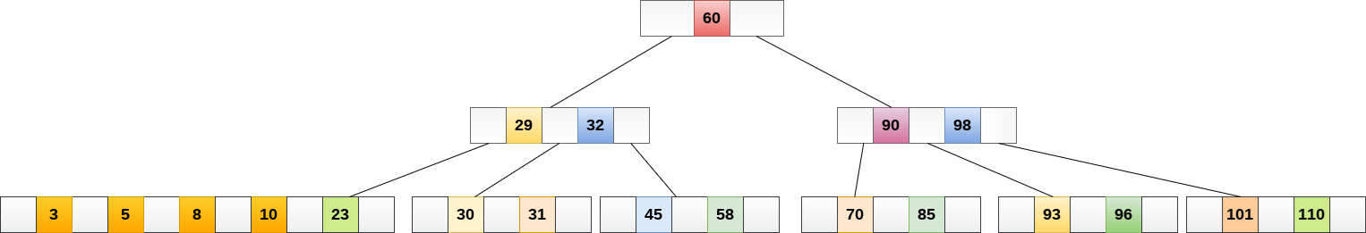
8 will be inserted to the right of 5, therefore insert 8.

Slide 67
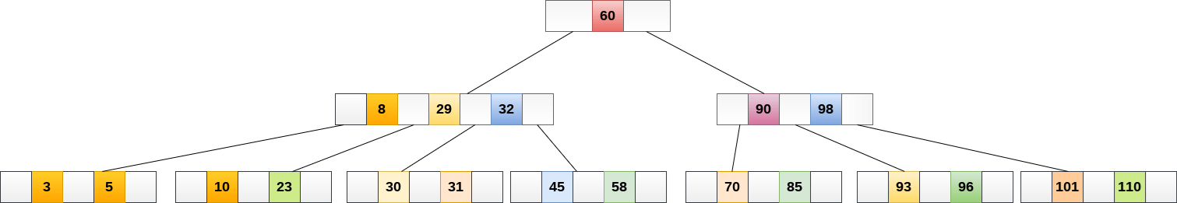
The node, now contain 5 keys which is greater than (5 -1 = 4 ) keys. Therefore split the node from the median i.e. 8 and push it up to its parent node shown as follows.

Slide 68
3.Deletion
Deletion is also performed at the leaf nodes. The node which is to be deleted can either be a leaf node or an internal node. Following algorithm needs to be followed in order to delete a node from a B tree.

Slide 69
Locate the leaf node.
If there are more than m/2 keys in the leaf node then delete the desired key from the node.
If the leaf node doesn't contain m/2 keys then complete the keys by taking the element from right or left sibling.
  If the left sibling contains more than m/2 elements then push its largest element up to its parent and move the intervening element down to the node where the key is deleted.
  If the right sibling contains more than m/2 elements then push its smallest element up to the parent and move intervening element down to the node where the key is deleted.
If neither of the sibling contain more than m/2 elements then create a new leaf node by joining two leaf nodes and the intervening element of the parent node.
If parent is left with less than m/2 nodes then, apply the above process on the parent too.

Slide 70
If the the node which is to be deleted is an internal node, then replace the node with its in-order successor or predecessor. Since, successor or predecessor will always be on the leaf node hence, the process will be similar as the node is being deleted from the leaf node.

Slide 71

Delete the node 53 from the B Tree of order 5 shown in the following figure.

Slide 72
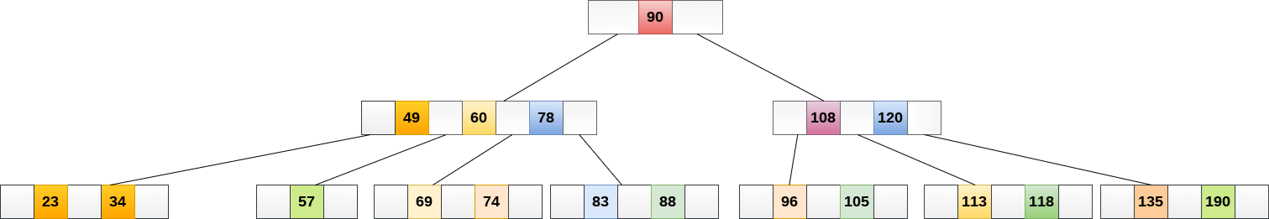
53 is present in the right child of element 49. Delete it.

Slide 73
Now, 57 is the only element which is left in the node, the minimum number of elements that must be present in a B tree of order 5, is 2. it is less than that, the elements in its left and right sub-tree are also not sufficient therefore, merge it with the left sibling and intervening element of parent i.e. 49.
The final B tree is shown as follows.

Slide 74
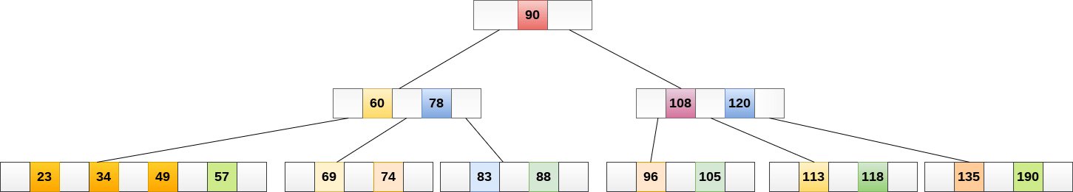

Slide 75
B+ Tree
B+ Tree is an extension of B Tree which allows efficient insertion, deletion and search operations.
In B Tree, Keys and records both can be stored in the internal as well as leaf nodes. Whereas, in B+ tree, records (data) can only be stored on the leaf nodes while internal nodes can only store the key values.
The leaf nodes of a B+ tree are linked together in the form of a singly linked lists to make the search queries more efficient.

Slide 76
B+ Tree are used to store the large amount of data which can not be stored in the main memory. Due to the fact that, size of main memory is always limited, the internal nodes (keys to access records) of the B+ tree are stored in the main memory whereas, leaf nodes are stored in the secondary memory.
The internal nodes of B+ tree are often called index nodes.

Slide 77
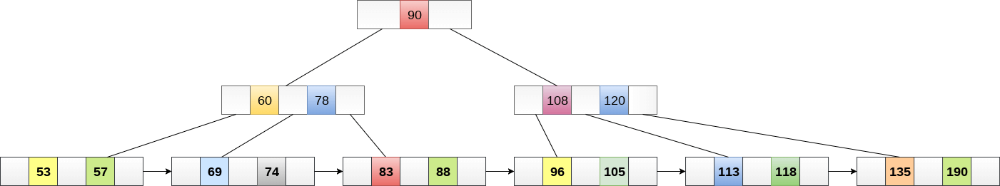

Slide 78
Advantages of B+ Tree
Records can be fetched in equal number of disk accesses.
Height of the tree remains balanced and less as compare to B tree.
We can access the data stored in a B+ tree sequentially as well as directly.
Keys are used for indexing.
Faster search queries as the data is stored only on the leaf nodes.

Slide 79
Insertion in B+ Tree
Step 1: Insert the new node as a leaf node
Step 2: If the leaf doesn't have required space, split the node and copy the middle node to the next index node.
Step 3: If the index node doesn't have required space, split the node and copy the middle element to the next index page.
Example :
Insert the value 195 into the B+ tree of order 5 shown in the following figure.

Slide 80
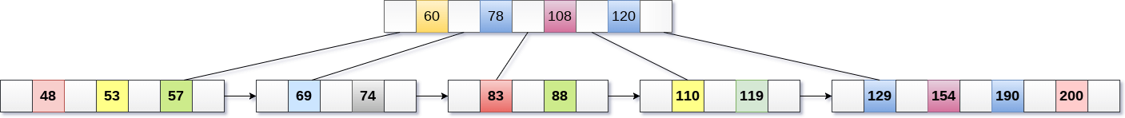

Slide 81
195 will be inserted in the right sub-tree of 120 after 190. Insert it at the desired position.

Slide 83


Slide 84
Deletion in B+ Tree
Step 1: Delete the key and data from the leaves.
Step 2: if the leaf node contains less than minimum number of elements, merge down the node with its sibling and delete the key in between them.
Step 3: if the index node contains less than minimum number of elements, merge the node with the sibling and move down the key in between them.
Example
Delete the key 200 from the B+ Tree shown in the following figure.

Slide 85


Slide 86


Slide 87


Slide 88

Now, element 120 is the single element present in the node which is violating the B+ Tree properties. Therefore, we need to merge it by using 60, 78, 108 and 120.

